Slide 1
Chapter 5: CPU Scheduling

Slide 2
Chapter 5: CPU Scheduling
Basic Concepts
Scheduling Criteria
Scheduling Algorithms

Slide 3
Objectives
To introduce CPU scheduling, which is the basis for multiprogrammed operating systems
To describe various CPU-scheduling algorithms
To discuss evaluation criteria for selecting a CPU-scheduling algorithm for a particular system

Slide 4
Basic Concepts
Maximum CPU utilization obtained with multiprogramming
CPU–I/O Burst Cycle – Process execution consists of a cycle of CPU execution and I/O wait
CPU burst distribution

Slide 5
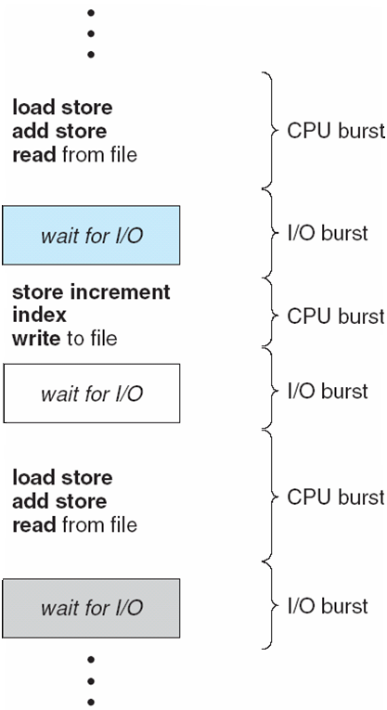
Alternating Sequence of CPU and I/O Bursts

Slide 6
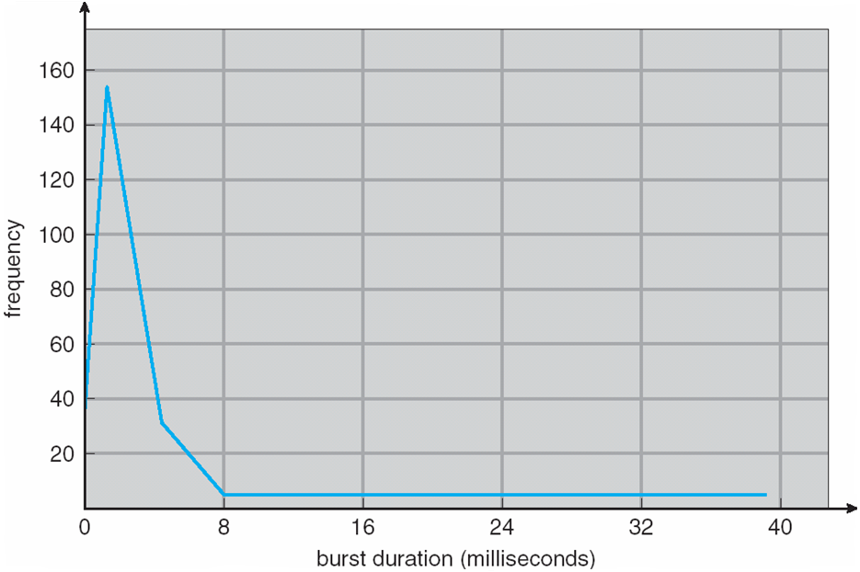
Histogram of CPU-burst Times
An I/O-bound program typically has many short CPU bursts
A CPU-bound program might have a few long CPU bursts
This distribution is important in the selection of an appropriate CPU-scheduling algorithm

Slide 7
CPU Scheduler
Selects from among the processes in ready queue, and allocates the CPU to one of them
Queue may be ordered in various ways
CPU scheduling decisions may take place when a process:
1. Switches from running to waiting state
2. Switches from running to ready state
3. Switches from waiting to ready
Terminates

Slide 8
CPU Scheduler
Scheduling under 1 and 4 is nonpreemptive
All other scheduling is preemptive
Consider access to shared data
Consider preemption while in kernel mode
Consider interrupts occurring during crucial OS activities

Slide 9
Dispatcher
Dispatcher module gives control of the CPU to the process selected by the short-term scheduler; this involves:
switching context
switching to user mode
jumping to the proper location in the user program to restart that program
Dispatch latency – time it takes for the dispatcher to stop one process and start another running

Slide 10
Scheduling Criteria
CPU utilization – keep the CPU as busy as possible
Throughput – # of processes that complete their execution per time unit
Turnaround time – amount of time to execute a particular process
Waiting time – amount of time a process has been waiting in the ready queue
Response time – amount of time it takes from when a request was submitted until the first response is produced, not output (for time-sharing environment)

Slide 11
Scheduling Algorithm Optimization Criteria
Max CPU utilization
Max throughput
Min turnaround time
Min waiting time
Min response time

Slide 12
Preemptive and non-preemptive scheduling
Non-Preemptive Scheduling
A process is removed from the CPU by itself (system call) or by an interrupt generated by some other system component. After interrupt is serviced, the CPU may be assigned to any process that is ready to run.
Preemptive Scheduling
If an interrupt causes the removal of a process from the CPU, after the interrupt is serviced the CPU is given back to the process that had the CPU.

Slide 13
First-Come, First-Served (FCFS) Scheduling
Process Burst Time
P₁ 24
P₂ 3
P₃ 3
Suppose that the processes arrive in the order: P₁ , P₂ , P₃ The Gantt Chart for the schedule is:
Waiting time for P₁ = 0; P₂ = 24; P₃ = 27
Average waiting time: (0 + 24 + 27)/3 = 17
P₁
P₂
P₃
0
24
27
30

Slide 14
FCFS Scheduling (Cont.)
Suppose that the processes arrive in the order:
P₂ , P₃ , P₁
The Gantt chart for the schedule is:
Waiting time for P₁ = 6; P₂ = 0; P₃ = 3
Average waiting time: (6 + 0 + 3)/3 = 3
Much better than previous case
Convoy effect - short process behind long process
Consider one CPU-bound and many I/O-bound processes
P₂
P₃
P₁
0
3
6
30

Slide 15
FCFS Scheduling (Cont.)
Non-preemptive
Processes are assigned the CPU in the same order as they arrive at the Ready Queue
Advantage: Easy to implement and fairness (no starvation)
Disadvantage: Low overall system throughput

Slide 16
Shortest-Job-First (SJF) Scheduling
Associate with each process the length of its next CPU burst
Use these lengths to schedule the process with the shortest time
The earlier the I/O begins -the more work done by the system
Nonpreemptive – once CPU given to the process it cannot be preempted until completes its CPU burst
Advantage
SJF is optimal – gives minimum average waiting time for a given set of processes
Disadvantage
Non preemptive nature is not good for time sharing
The difficulty is knowing the length of the next CPU request
Could ask the user

Slide 17
Example of SJF
ProcessesArriva l Time Burst Time
P₁ 0.0 6
P₂ 2.0 8
P₃ 4.0 7
P₄ 5.0 3
SJF scheduling chart
Average waiting time = (3 + 16 + 9 + 0) / 4 = 7
P₄
P₁
P₃
P₂
0
3
9
16
24

Slide 18
Example of Non-Preemptive SJF
Process Arrival Time Burst Time
P₁ 0 7
P₂ 2 4
P₃ 4 1
P₄ 5 4
SJF (non-preemptive)
Average waiting time = (0 + 6 + 3 + 7)/4 = 4
P₁
P₃
P₂
P₄
0
3
7
8
12
16

Slide 19
Determining Length of Next CPU Burst
Can only estimate the length – should be similar to the previous one
Then pick process with shortest predicted next CPU burst
Can be done by using the length of previous CPU bursts, using exponential averaging
Commonly, α set to ½

Slide 20
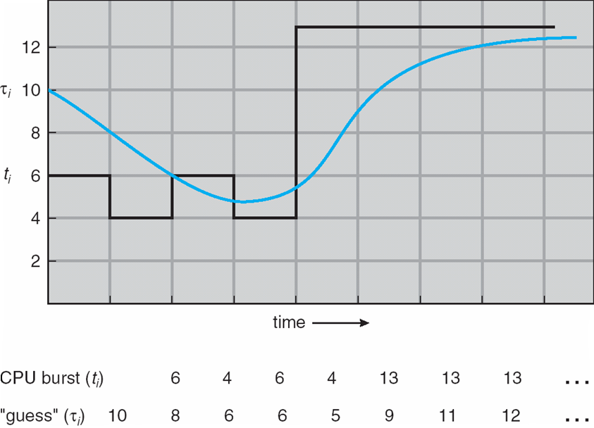
Prediction of the Length of the Next CPU Burst

Slide 21
Examples of Exponential Averaging
α =0
τ_{n+1} = τ_{n}
Recent history does not count
α =1
τ_{n+1} = α t_{n}
Only the actual last CPU burst counts
If we expand the formula, we get:
τ_{n+1} = α t_{n}+(1 - α)α t_{n} ₋₁ + …+(1 - α )^{j} α t_{n} _{-j} + … +(1 - α )^{n +1} τ₀
Since both α and (1 - α) are less than or equal to 1, each successive term has less weight than its predecessor

Slide 22
Shortest-remaining-time-first
After every interrupt select the process with shortest next burst time
Preemptive – if a new process arrives with CPU burst length less than remaining time of current executing process, preempt.

Slide 23
Shortest Remaining Time First (Preemptive)
After every interrupt, select the process with shortest next burst time
Advantage:
Can yield minimum average waiting time
Disadvantage:
Increased Overhead

Slide 24
Example of Shortest-remaining-time-first
Now we add the concepts of varying arrival times and preemption to the analysis
ProcessA arri Arrival TimeT Burst Time
P₁ 0 8
P₂ 1 4
P₃ 2 9
P₄ 3 5
Preemptive SJF Gantt Chart
Average waiting time = [(10-1)+(1-1)+(17-2)+5-3)]/4 = 26/4 = 6.5 msec
P₁
P₂
P₄
P₁
P₃
0
1
5
10
17
26

Slide 25
Priority Scheduling
A priority number (integer) is associated with each process
The CPU is allocated to the process with the highest priority (smallest integer ≡ highest priority)
Preemptive
Nonpreemptive
SJF is priority scheduling where priority is the inverse of predicted next CPU burst time
Problem ≡ Starvation – low priority processes may never execute
Solution ≡ Aging – as time progresses increase the priority of the process

Slide 26
Example of Priority Scheduling
ProcessA arri Burst TimeT Priority
P₁ 10 3
P₂ 1 1
P₃ 2 4
P₄ 1 5
P₅ 5 2
Priority scheduling Gantt Chart
Average waiting time = 8.2 msec
P₂
P₅
P₁
P₃
P₄
0
1
6
16
18
19

Slide 27
Round Robin (RR)
Each process gets a small unit of CPU time (time quantum q), usually 10-100 milliseconds. After this time has elapsed, the process is preempted and added to the end of the ready queue.
If there are n processes in the ready queue and the time quantum is q, then each process gets 1/n of the CPU time in chunks of at most q time units at once. No process waits more than (n-1)q time units.
Timer interrupts every quantum to schedule next process
Performance
q large ⇒ FIFO
q small ⇒ q must be large with respect to context switch, otherwise overhead is too high

Slide 28
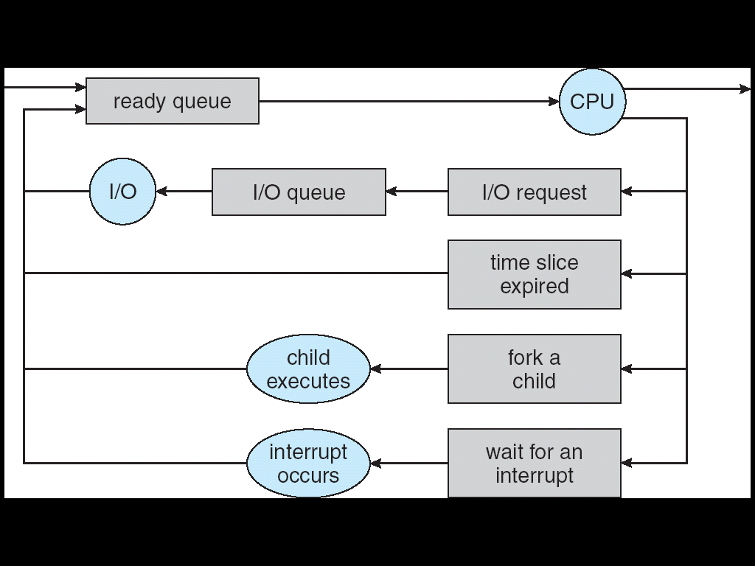
Round Robin (RR) (Preemptive)
When an interrupt occurs, the process that had the CPU is placed at the tail of the ready queue
Advantage:
Easy to implement for time sharing environments and fairness
Disadvantage:
Long average waiting time

Slide 29
Example of RR with Time Quantum = 4
Process Burst Time
P₁ 24
P₂ 3
P₃ 3
The Gantt chart is:
Typically, higher average turnaround than SJF, but better response
q should be large compared to context switch time
q usually 10ms to 100ms, context switch < 10 usec
P₁
P₂
P₃
P₁
P₁
P₁
P₁
P₁
0
4
7
10
14
18
22
26
30

Slide 30
Example of RR with Time Quantum = 20
Process Burst Time
P₁ 53
P₂ 17
P₃ 68
P₄ 24
The Gantt chart is:
Typically, higher average turnaround than SJF, but better response
P₁
P₂
P₃
P₄
P₁
P₃
P₄
P₁
P₃
P₃
0
20
37
57
77
97
117
121
134
154
162

Slide 31
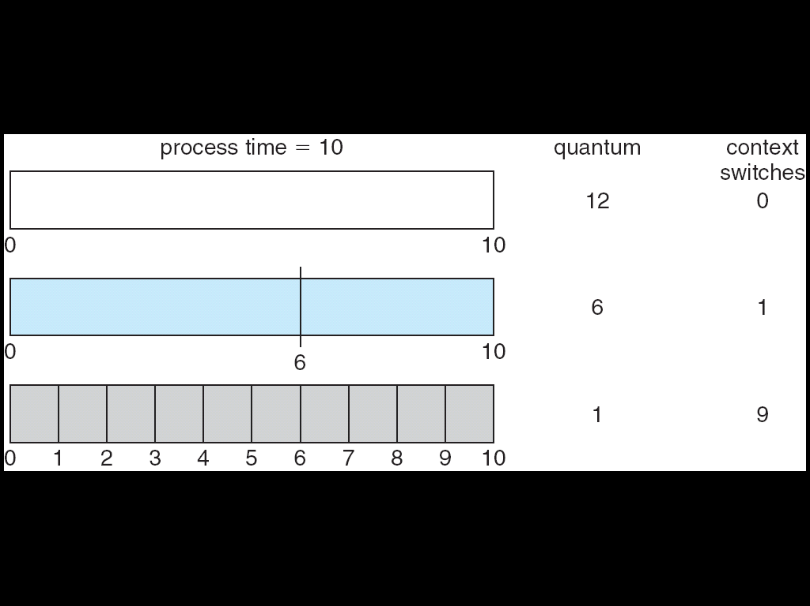
Time Quantum and Context Switch Time
The performance of the RR algorithm depends heavily on the size of the time quantum.
If the time quantum is extremely large, the RR policy the same as FCFS. If the time quantum is extremely small, the RR approach is called processor sharing.

Slide 32
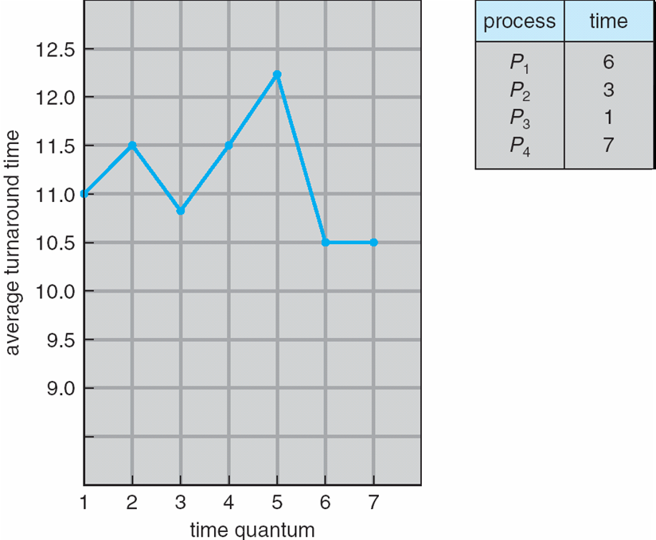
Turnaround Time Varies With The Time Quantum

Slide 33
Multilevel Queue
Ready queue is partitioned into separate queues, eg:
foreground (interactive)
background (batch)
Process permanently in a given queue
Each queue has its own scheduling algorithm:
foreground – RR
background – FCFS
Scheduling must be done between the queues:
Fixed priority scheduling; (i.e., serve all from foreground then from background). Possibility of starvation.
Time slice – each queue gets a certain amount of CPU time which it can schedule amongst its processes; i.e., 80% to foreground in RR
20% to background in FCFS

Slide 34
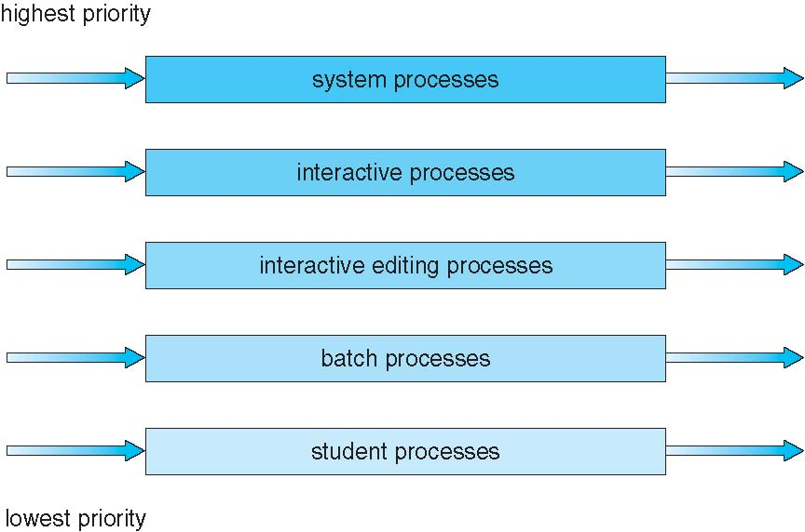
Multilevel Queue Scheduling

Slide 35
Multilevel Feedback Queue
A process can move between the various queues; aging can be implemented this way
Multilevel-feedback-queue scheduler defined by the following parameters:
number of queues
scheduling algorithms for each queue
method used to determine when to upgrade a process
method used to determine when to demote a process
method used to determine which queue a process will enter when that process needs service

Slide 36
Example of Multilevel Feedback Queue
Three queues:
Q₀ – RR with time quantum 8 milliseconds
Q₁ – RR time quantum 16 milliseconds
Q₂ – FCFS
Scheduling
A new job enters queue Q₀ which is served FCFS
When it gains CPU, job receives 8 milliseconds
If it does not finish in 8 milliseconds, job is moved to queue Q₁
At Q₁ job is again served FCFS and receives 16 additional milliseconds
If it still does not complete, it is preempted and moved to queue Q₂

Slide 37
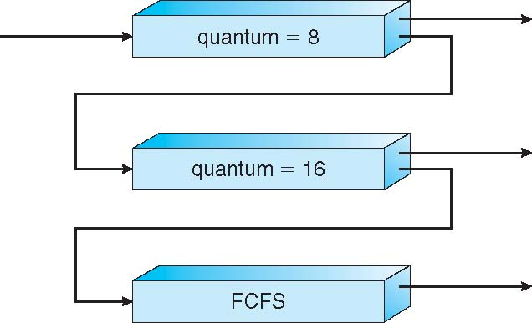
Multilevel Feedback Queues

Slide 38
Example
The CPU and I/O times for 2 processes are shown below. Assume that PI gets to the ready queue just before P2 and the scheduling algorithm used by the OS is Round Robin with a time slice of 3 time units. Assume that the I/Os for the processes are different so that there is no I/O queue. Assume also that an interrupt from a completed I/O for process "X" will place process "X" in the ready queue BEHIND the process that was just interrupted.
Using the first empty graph, describe how the CPU will be assigned to each process and for how long.
U se the second empty graph to show ALL the states that P1 goes through and the amount of time it has remained in that state until it has halted.
CPU
2
3
4
halt
P1
1
2
I/O
1
5
2
CPU
halt
P2
1
3
I/O

Slide 39
Example
States of P1 and P2
Busy CPU
Idle CPU
STATES
P2

